Slide 1

The network rebalances the library: patterns and questions
Lorcan Dempsey
OCLC Research
9 August 2013
DALNET Educational Forum/Annual Meeting
@LorcanD

Slide 2
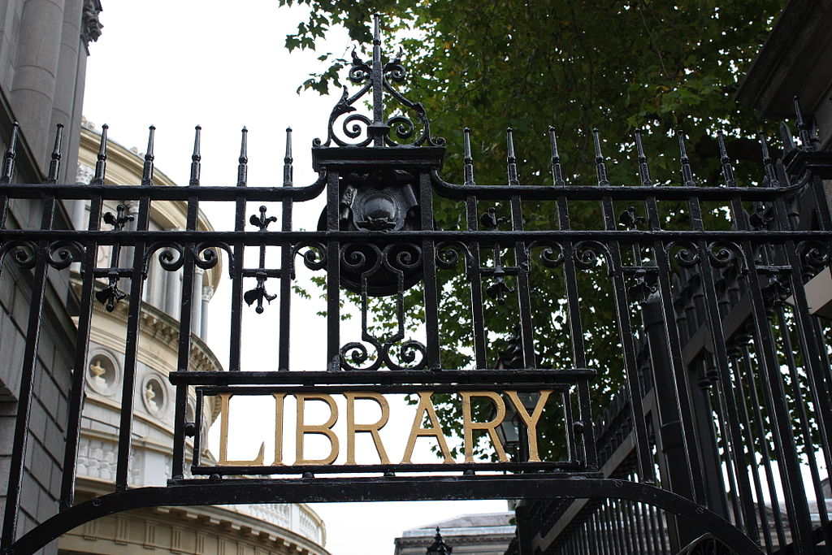
By Ardfern (Own work) [CC-BY-SA-3.0 (http://creativecommons.org/licenses/by-sa/3.0) via Wikimedia Commons
People should think not so much of the books that have gone into the … Library but rather of the books that have come out of it. Seán O'Faoláin

Slide 3
Prelude

Slide 4
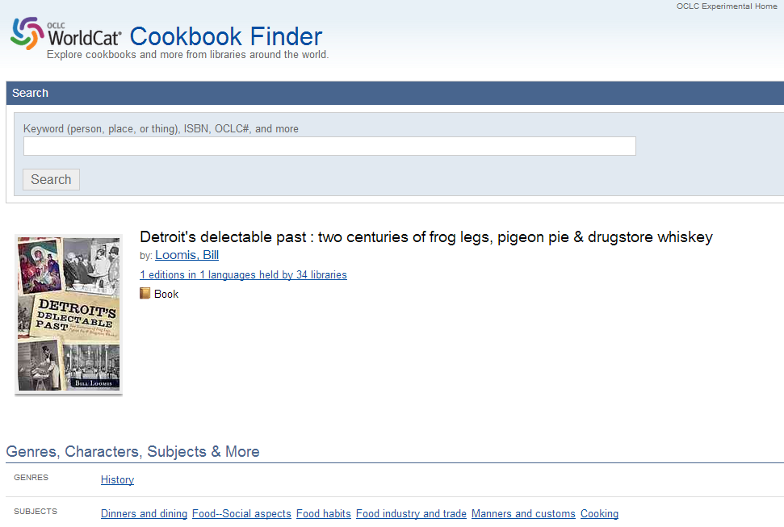

Slide 5
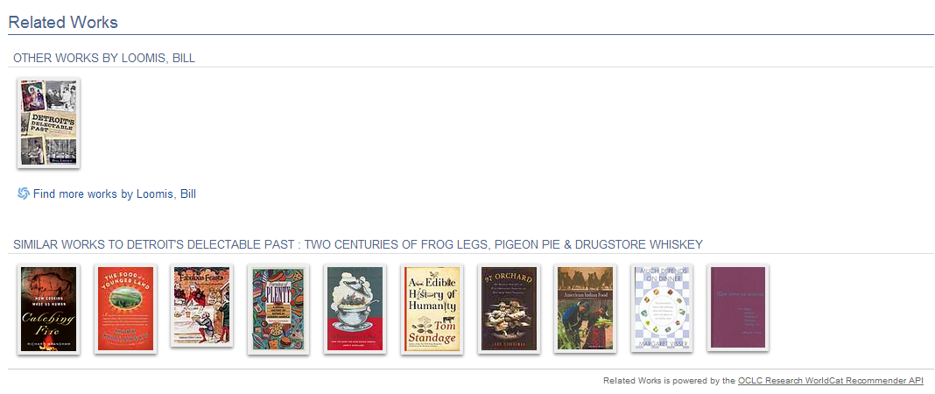

Slide 6
Prelude

Slide 7
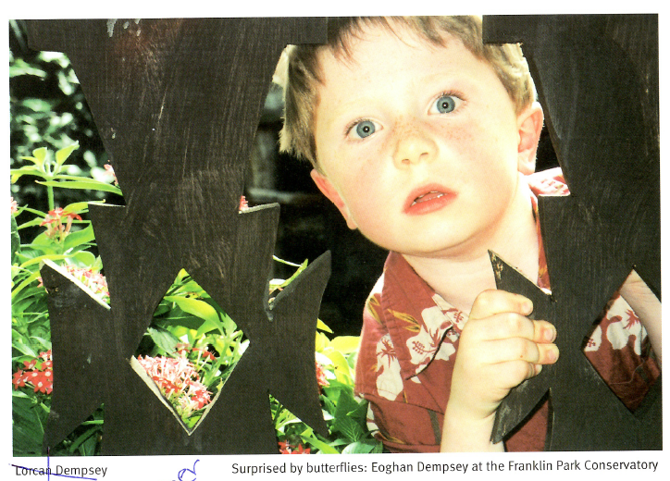

Slide 8



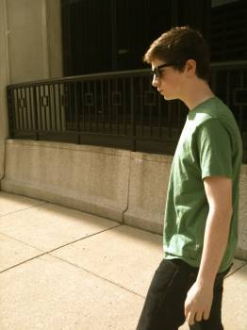
Eoghan

Slide 9
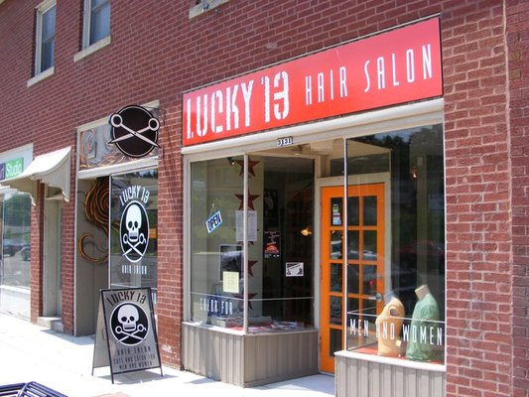

Lorcan and Eoghan

Slide 10
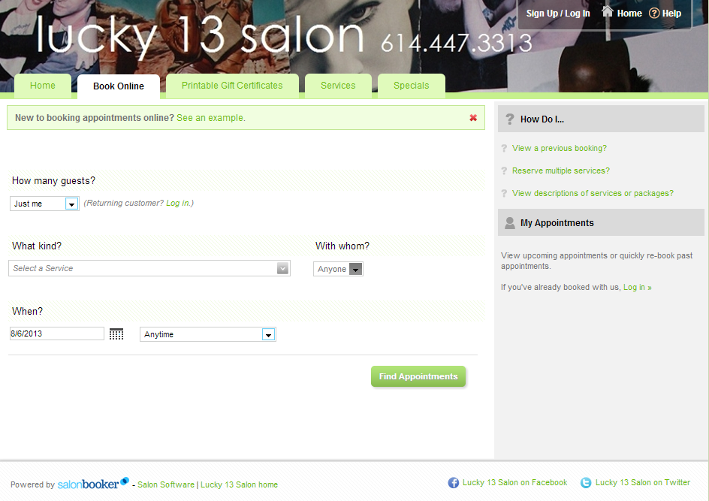

Slide 11
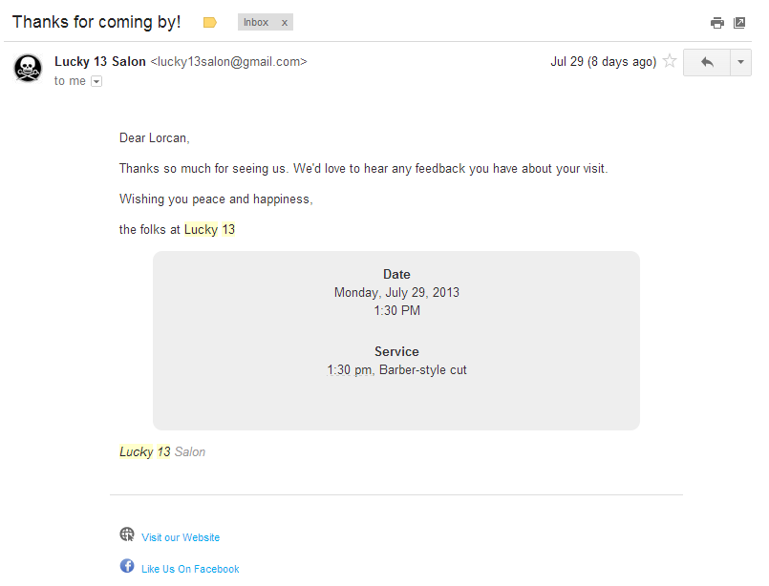

Slide 12
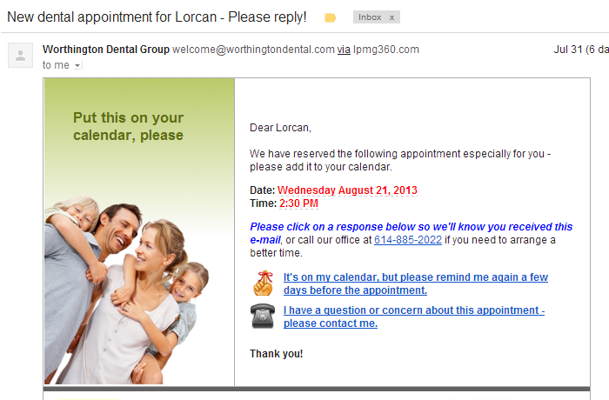

Slide 13
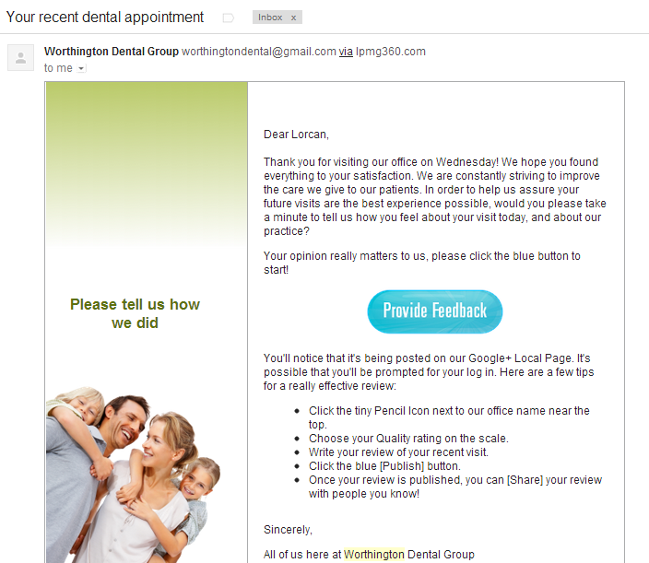

Slide 14
Note ..
Rightscaling infrastructure
Shift to engagement

Slide 15
Prelude

Slide 16
What has changed
1
Now: resources are abundant and attention is scarce
Then: resources are scarce and attention is abundant

Slide 17

















Slide 18
What has changed?
2
The need for local infrastructure or local assembly of materials has declined as …

Slide 19

High transaction
costs led to
locally
assembled
collections.

Slide 20

U Minnesota, ARL Institutional profile
“In alignment with the University's strategic positioning, the University Libraries have re-conceived goals, shifting from a collection-centric focus to one that is engagement-based.”
http://umcf.umn.edu/awards/2006/images/margo_library_lg.jpg

Slide 21
“
Colleges and universities have long competed against one another, measuring themselves in comparison to each other and holding tightly to their idiosyncrasies as defining elements of their status. But today, the distribution and reuse of information digitally via the Internet is rapidly changing the game, rewarding those who instead aggregate and scale toward a common infrastructure. It is becoming increasingly clear that neither the challenges that confront colleges and universities nor the solutions to those challenges are unique to each institution.
Chuck Henry and Brad Wheeler
The game has changed
Educause Review, March 2012

Slide 22





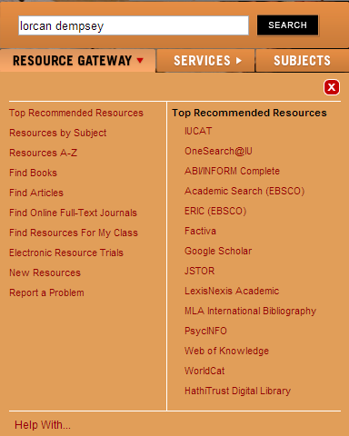


“aggregate and scale towards a common infrastructure”

Slide 23
What has changed?
3
The library is institution scale where many of its users operate at network scale

Slide 24
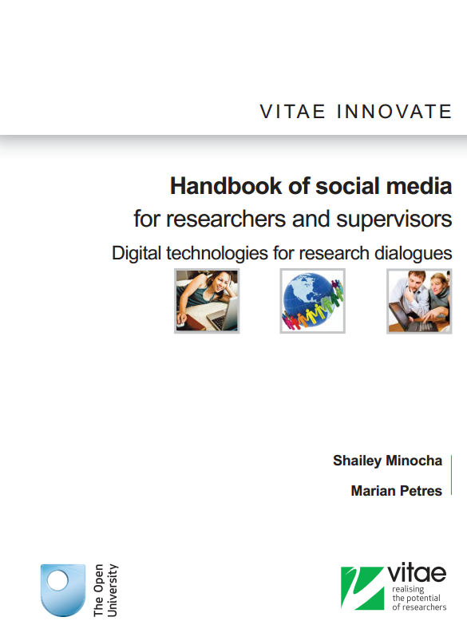
Researchers prefer to adopt open source and social media technologies that are available in the public domain rather than institutional license-based applications ….. First the social media technologies facilitate networking and community building. Second, researchers prefer to use technologies that will enable them access to resources and their own materials beyond their institution-based PhD research.
“
e.g. Mendeley, Zotero, Endnote

Slide 25
What has changed
4
Now: Library services are built around the user’s workflow
Then: User’s workflow built around library services

Slide 26
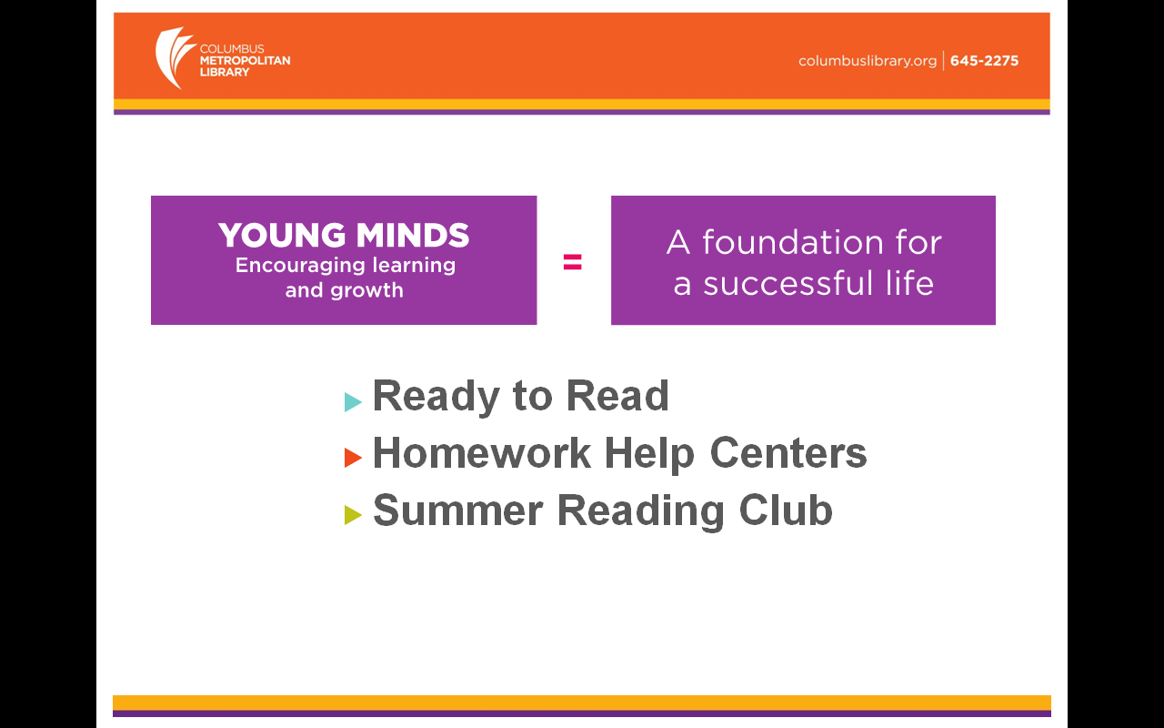
Slide from Pat Losinski, CEO Columbus Metropolitan Library

Slide 27
A shift to engagement …
… the inside out library .. the library as an actor in the research and learning environments of its users …
(and look out for examples of rightscaling infrastructure)

Slide 28
Outside in
Inside out
User builds workflow around library services
Towards a centered network presence
Locally assemble externally acquired colls
Discovery happens in the library
Expertise hidden
Configure space around collections
Library services built around user workflows
Towards a decentered network presence
Engage with creation, management, use and sharing of all information resources
Discovery happens elsewhere
Expertise visible
Configure space around engagement

Slide 29
Now: towards the decentered library
2
Then: towards the centered library
Thanks to my colleague JD Shipengrover for help with the pictures in this section

Slide 30
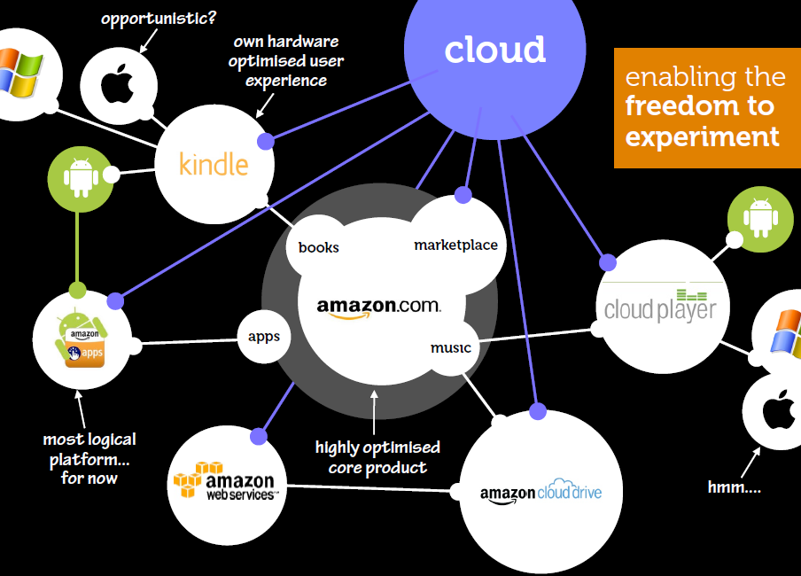
Not just a site but an ecosystem
Beyond the mobile web. Stephanie Rieger. http://www.slideshare.net/yiibu/beyond-themobilewebbyyiibu

Slide 31
Network Presence
John Doe University Library
Website
John Doe University Library
Decoupled Communication
External Syndication
Cloud Sourced

Slide 32






Decoupled Communication
Flickr
Blogs
Facebook
Twitter
Google
Youtube
Discovery
Knowledgebase
Libguides
Cloud Sourced
Resolver

Slide 33
WorldCat
ArchivesGrid
Metadata
Summon
Scirus
Blogs
Suncat
Europeana
RSS
Catalogue
Ethos
Mobilepp
Proxy Toolbar
Dspace
Linked Data (Catalog)
OAI-PMH (Dspace)
Discovery
Services
Proxy Widgets
External Syndication
Library APIs
Z39.50
Data
Jorum
Digital Archive

Slide 34
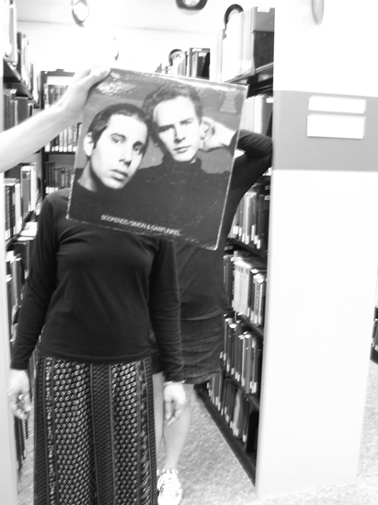
Creating conversations
around collections:
Sleevefacing at
Bowling Green State Univ
http://blogs.bgsu.edu/librarysleevefacing/2012/08/15/bookends/

Slide 35
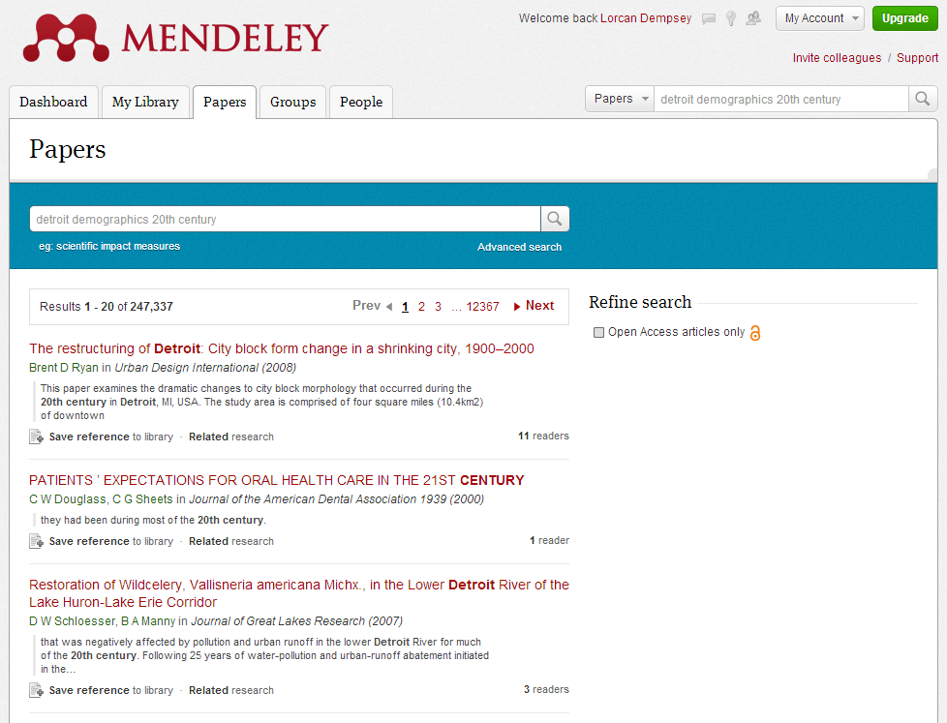

Slide 36
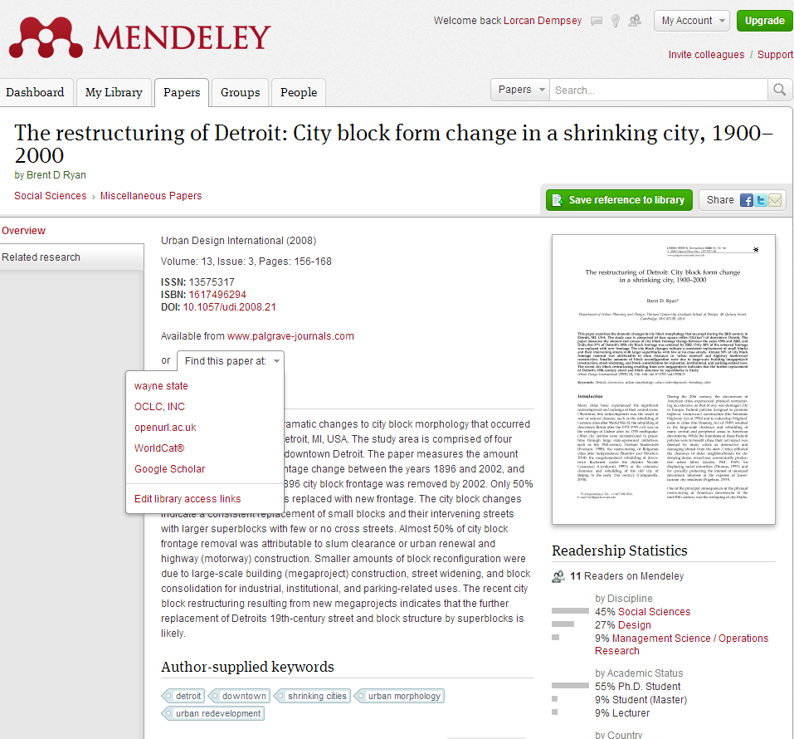

Slide 37
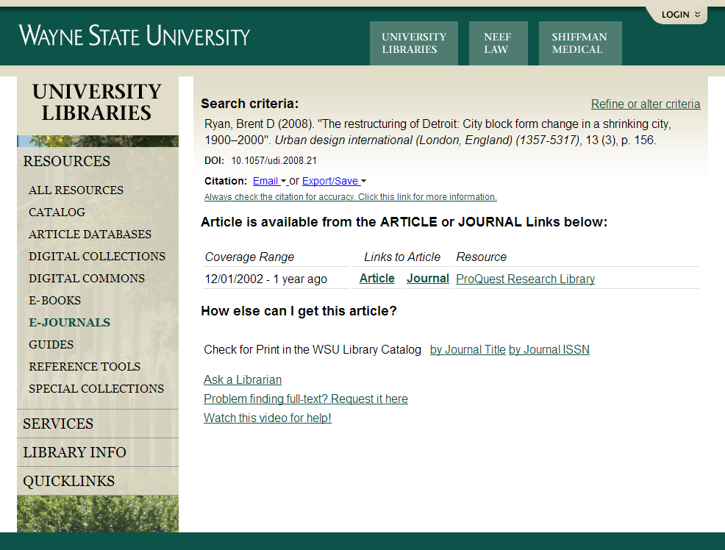

Slide 38
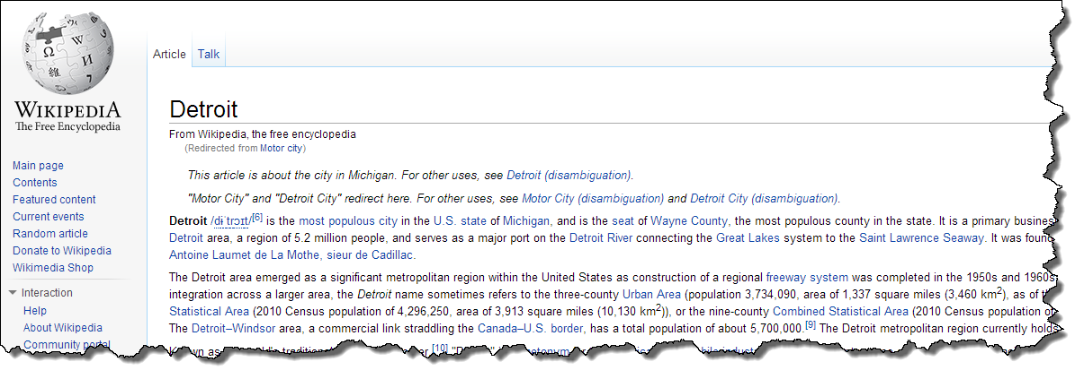
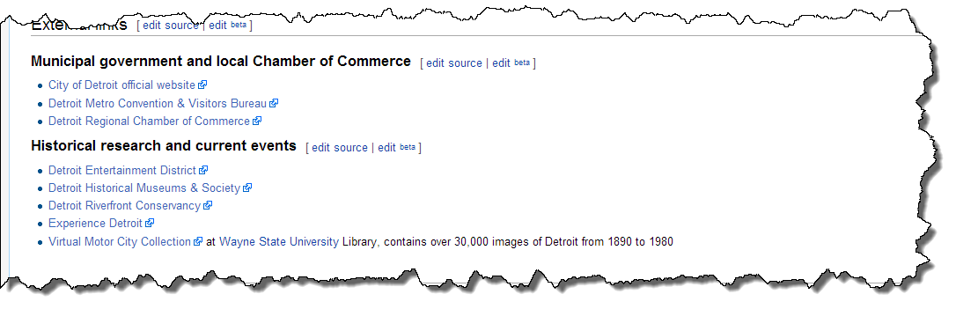

Slide 39
Now: engage with creation, management, use and sharing of all information resources
3
Then: acquire external resources

Slide 40
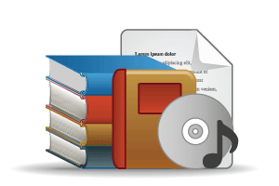



COLLECTIONS GRID
(Lorcan Dempsey and Eric Childress, OCLC Research)
Stewardship/scarcity
high
low
In many collections
Low-High
Books & Journals
Newspapers
Gov Documents
CD & DVD
Maps
Scores
Low-Low
Freely-accessible web resources
Open source software
Newsgroup archives
low
Uniqueness
High Stewardship
Low Stewardship
High-Low
Research & Learning Materials
Institutional records
ePrints/tech reports
Learning objects
Courseware
E-portfolios
Research data
Prospectus
Insitutional website
High-High
Special Collections
Rare books
Local/Historical Newspapers
Local History Materials
Archives & Manuscripts
Theses & dissertations
high
In few collections

Slide 41
Collections Grid
Purchased Materials
Licensed E-Resources
In many collections
Open Web Resources
Licensed
Purchased
High Stewardship
Low Stewardship
Special Collections
Local Digitization
Research & Learning Materials
In few collections

Slide 42
Outside in Bought, licensed
Increased consolidation
Move from print to licensed
Manage down print – shared print
Move to user-driven models
Aim: to discover
Collections
Inside out
Institutional assets: special collections,
research and learning materials, institutional records, …
Reputation management
Increasingly important?
Aim: to *have* discovered … to disclose
Notes:
Licensed content will dominate in years to come.
Special collections will grow but only modestly (and only at some institutions); mostly growth in managing archival resources including institutional.
Much greater investment in managing research outputs.
No change in web archiving.

Slide 43
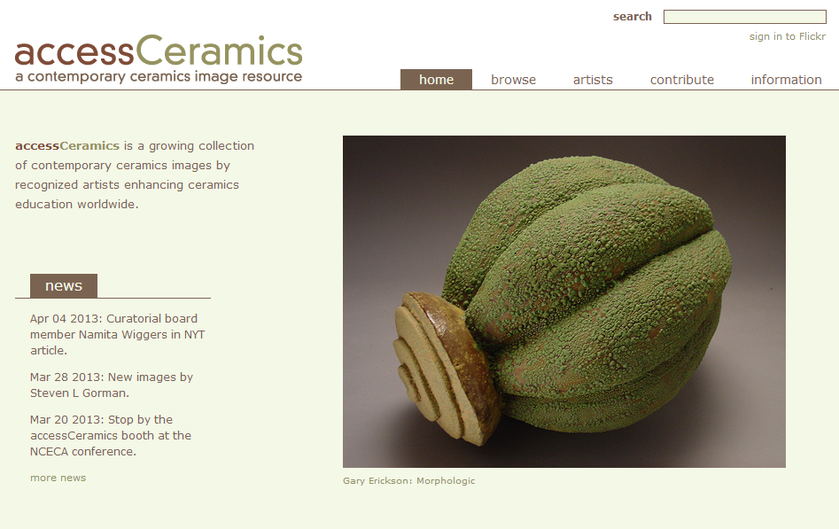

Collaboration with department around
community and learning resource
accessCeramics merges a traditional academic digital image collection's metadata capabilities with Flickr's openness and flexibility. It seeks to take advantage of Flickr's software tools and social network while also providing a web interface customized to this collection.

Slide 44
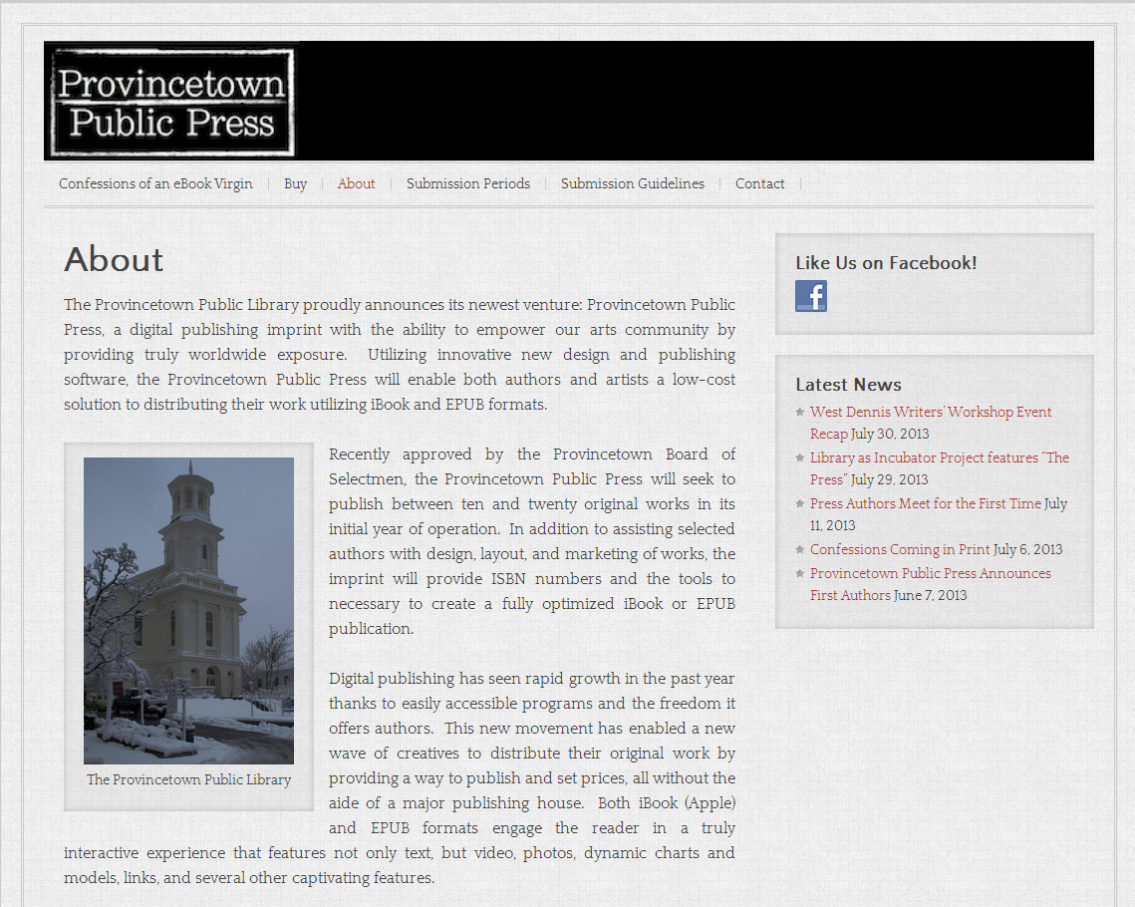

Slide 45
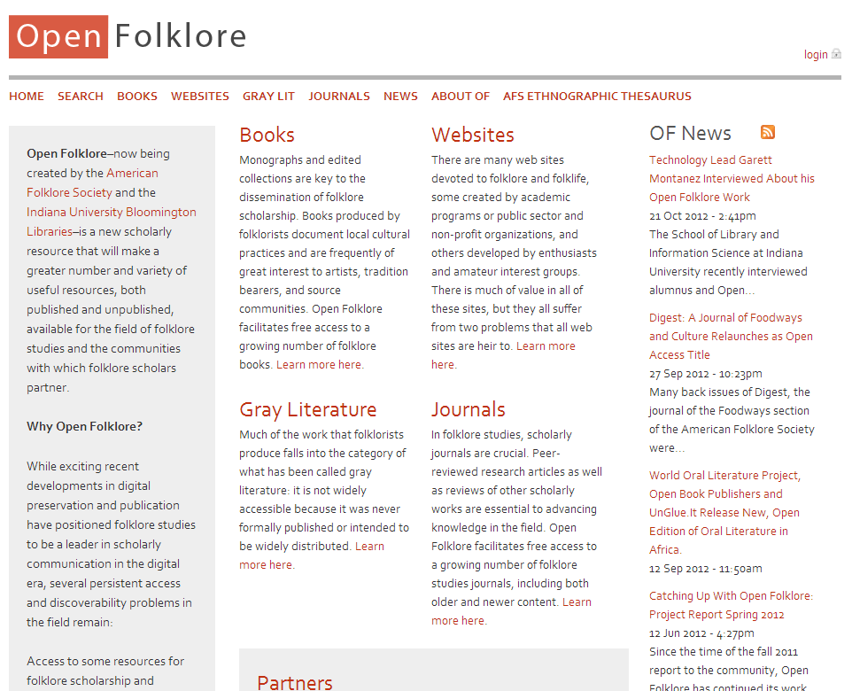
Explore new scholarly forms:
American Folklore Society
and libraries at Indiana U

Slide 46
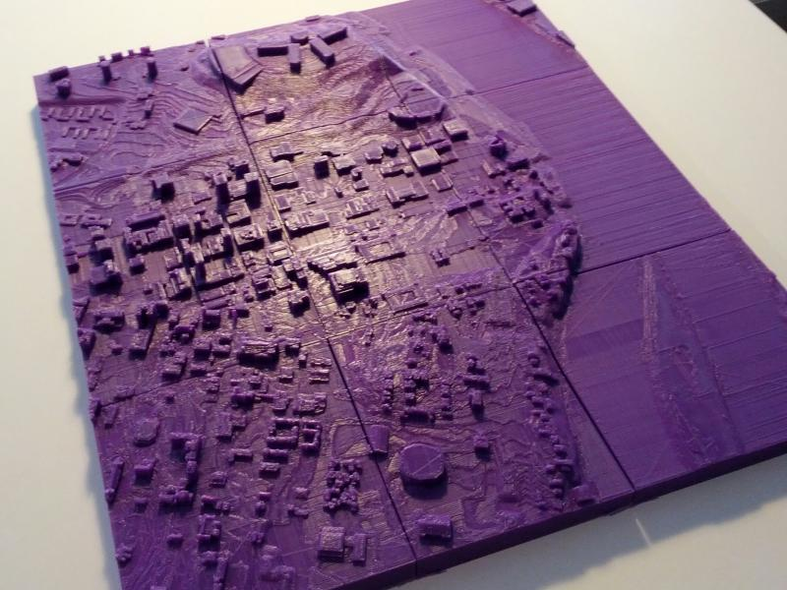
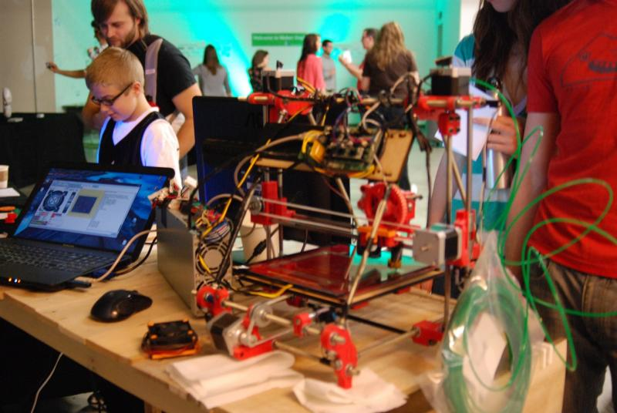
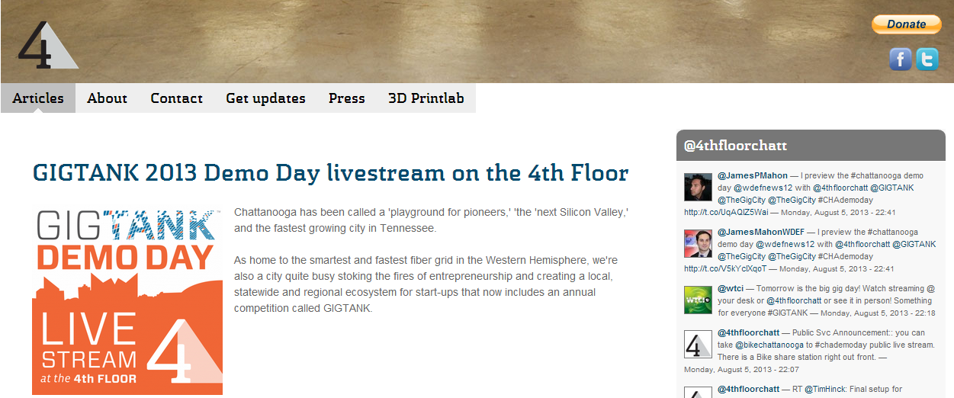

Slide 47
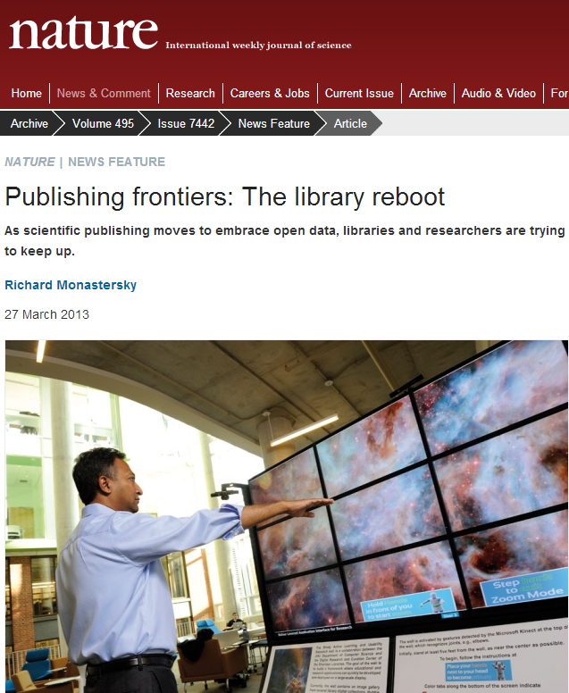
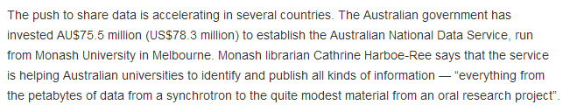
Curating data assets

Slide 48
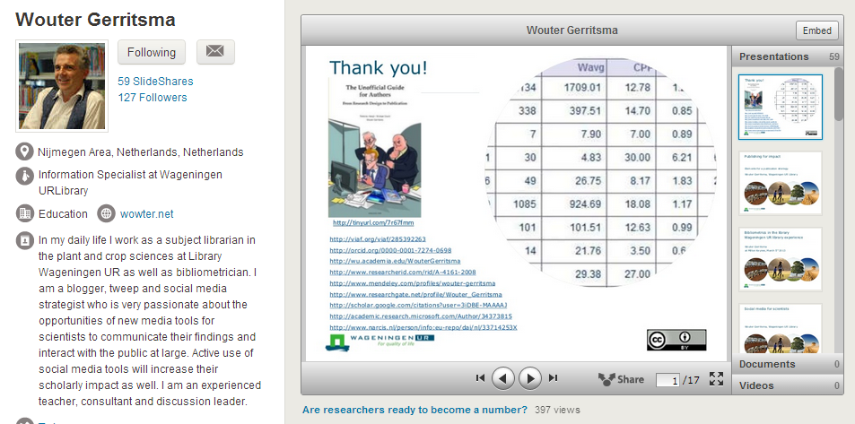
Bibliometrics and researcher identity

Slide 49
Now: discovery happens elsewhere
4
Then: discovery happens in the library

Slide 50
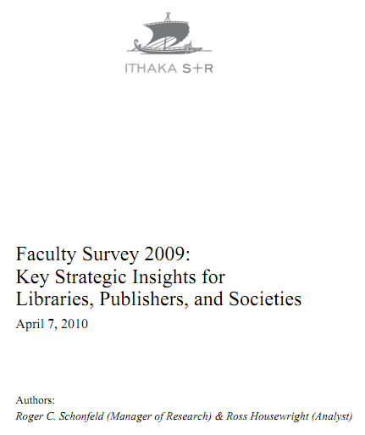
Ithaka s+r
Network-level discovery tools include disciplinary resources and powerful search tools which dramatically improve research efficiency while also increasing effectiveness. As a result, faculty discovery practices across all disciplines have continued their marked shift to the network level. This key finding has important implications for resource providers and libraries alike.
Faculty members are reducing their usage of
local library services for discovery purposes
and, as a result, put less value on the library’s
traditional intellectual value-added role as a
gateway to information.

Slide 51
Active promotion
Interpretation and promotion through social media
Syndication
  Metadata
  Links
  Services
Search engine optimization

Slide 52
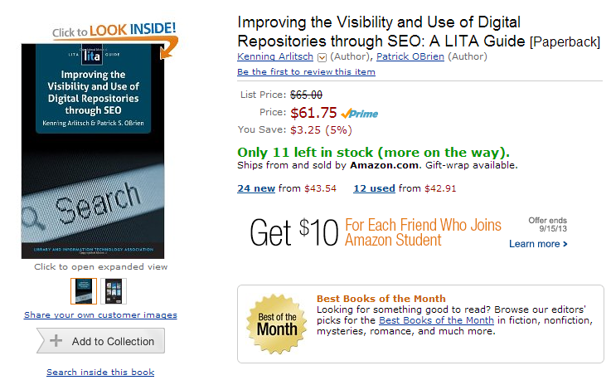

Slide 53
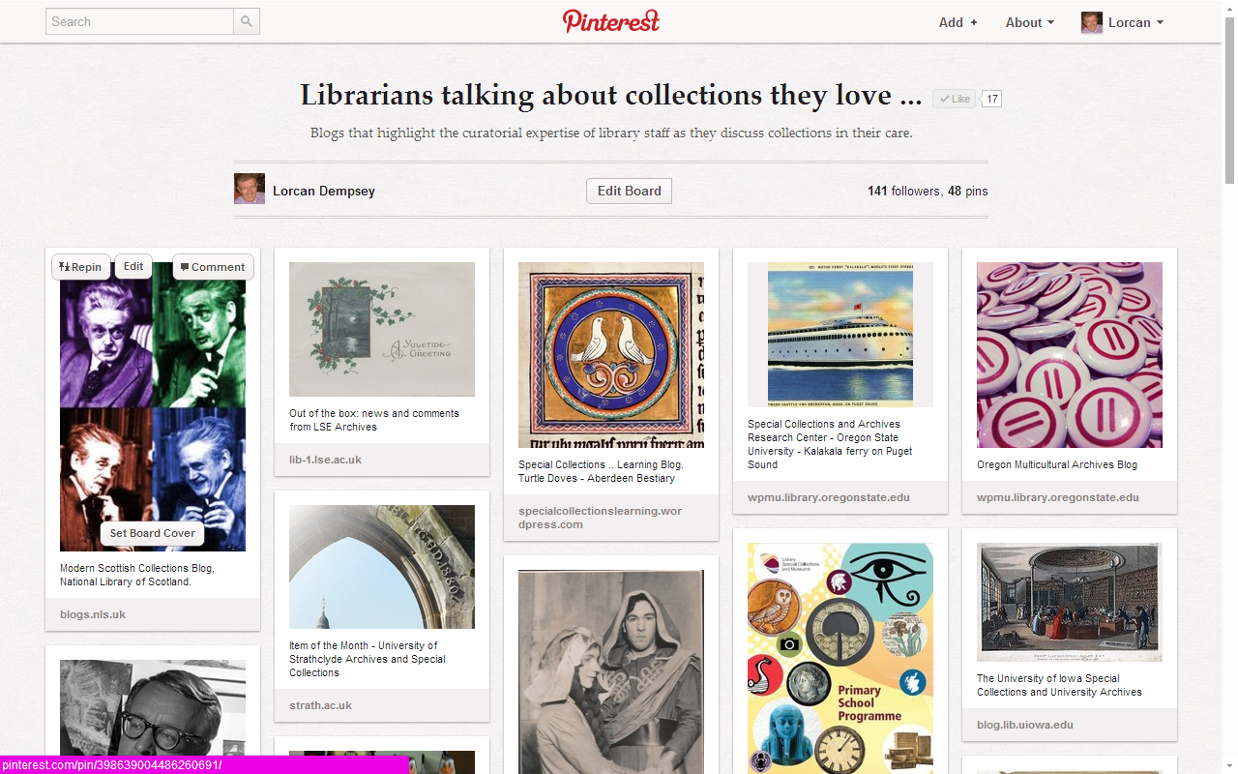

Slide 54
Now: visible
5
Then: hidden

Slide 55
If you want to be seen as expert …
… then your expertise has to be seen.

Slide 56
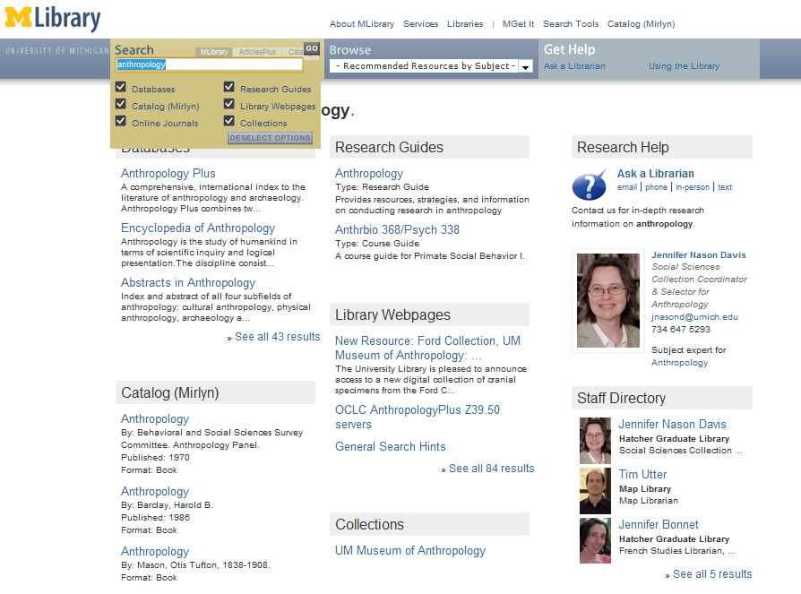
‘Indexing’ librarians at U Michigan

Slide 57
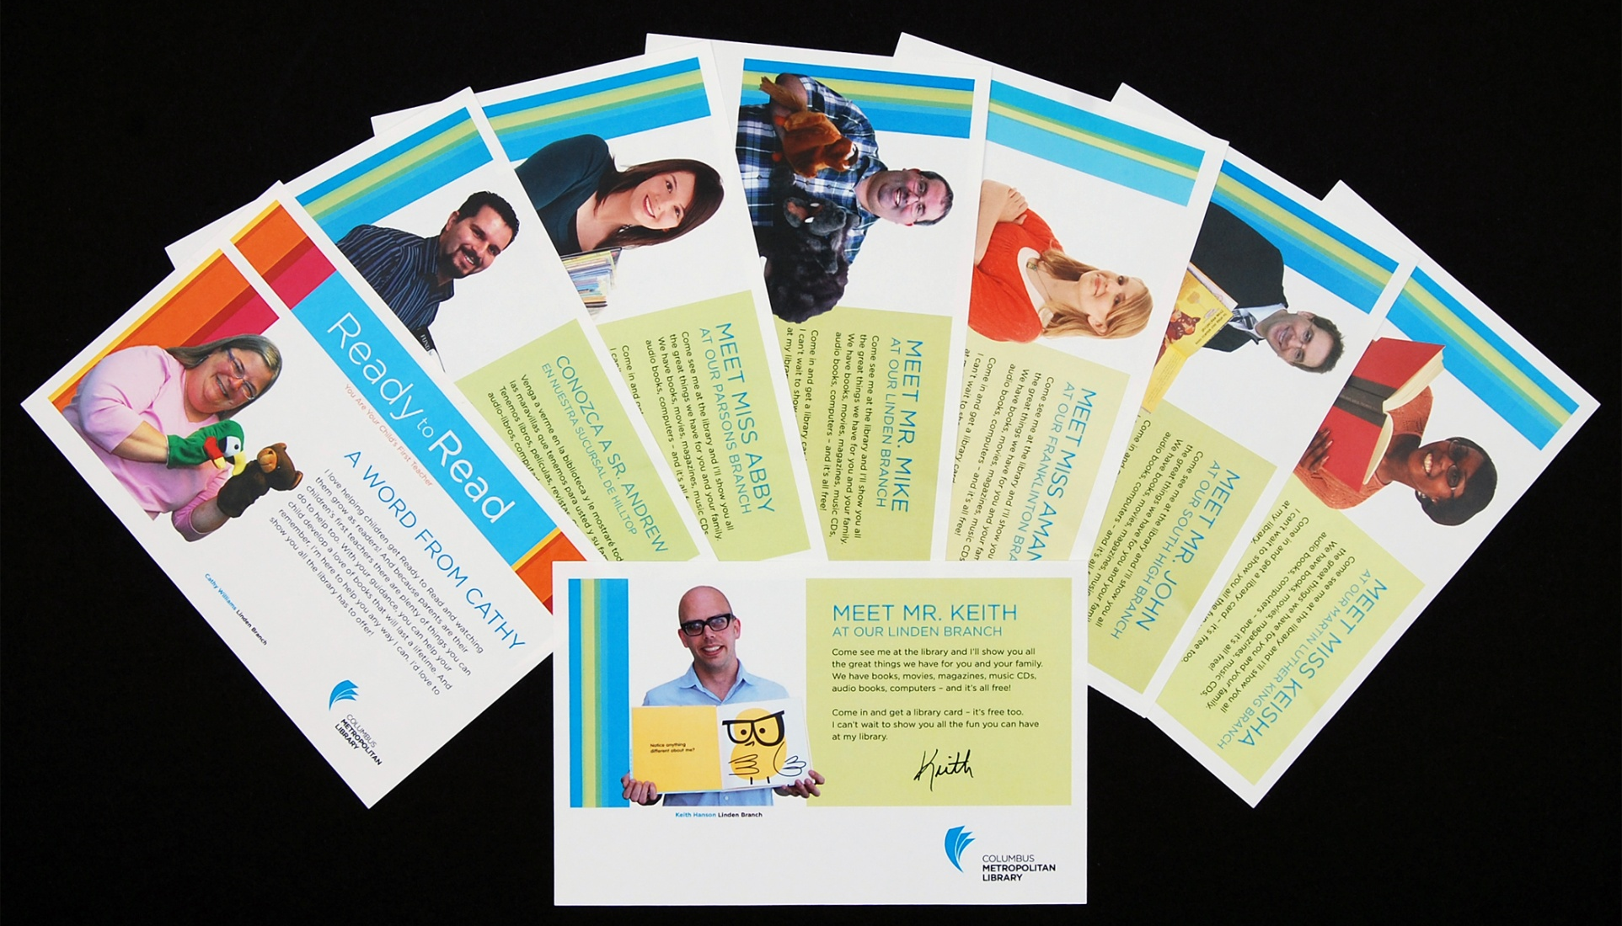
Slide from Pat Losinski, CEO Columbus Metropolitan Library

Slide 58
Now: space is configured around engagement with the user
6
Then: space is configured around collections

Slide 59

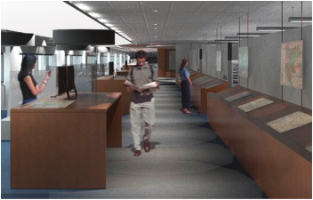
… unique combination of collections, government information expertise, and data services ….
Our new proximity, in a purposefully designed and equipped space, means that we can more effectively collaborate with each other, which in turn really enhances our ability to creatively collaborate with students, faculty, and researchers.
The new library features 60-foot long counter to enable the examination of large-format maps; a presentation space that will accommodate instruction; display cases and screens that showcase items from the print and digital collections; a large-format high-resolution scanner that produces digital copies for online work or the creation of full-size print copies; individual and group study spaces with dual-screen computers and laptop accessibility; and comfortable, moveable furniture for flexible study and collaboration.
We expect the Clark to become the campus nexus for the various data services that all disciplines increasingly require, …
Stephen
S. Clark
Library

Slide 60
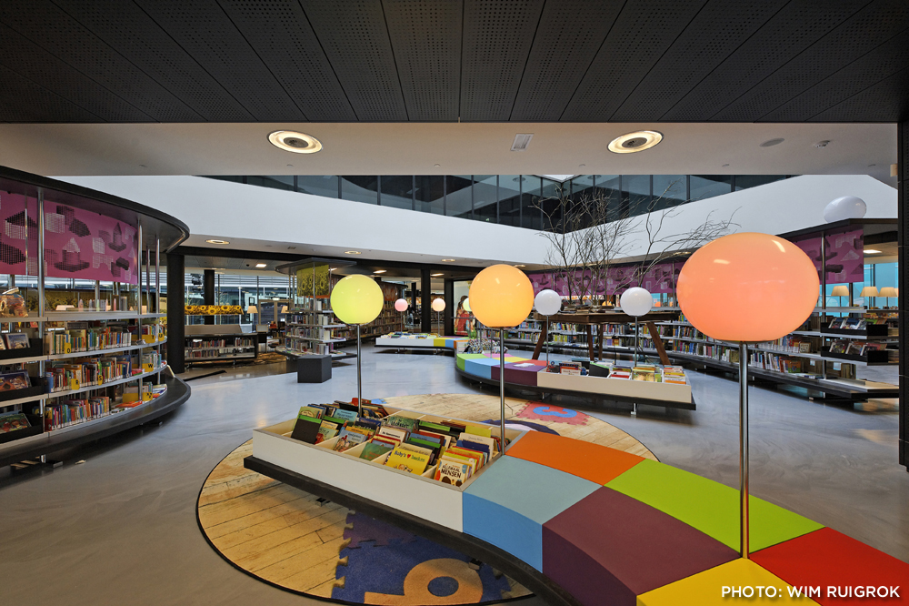
Almere Public Library, The Netherlands

Slide 61
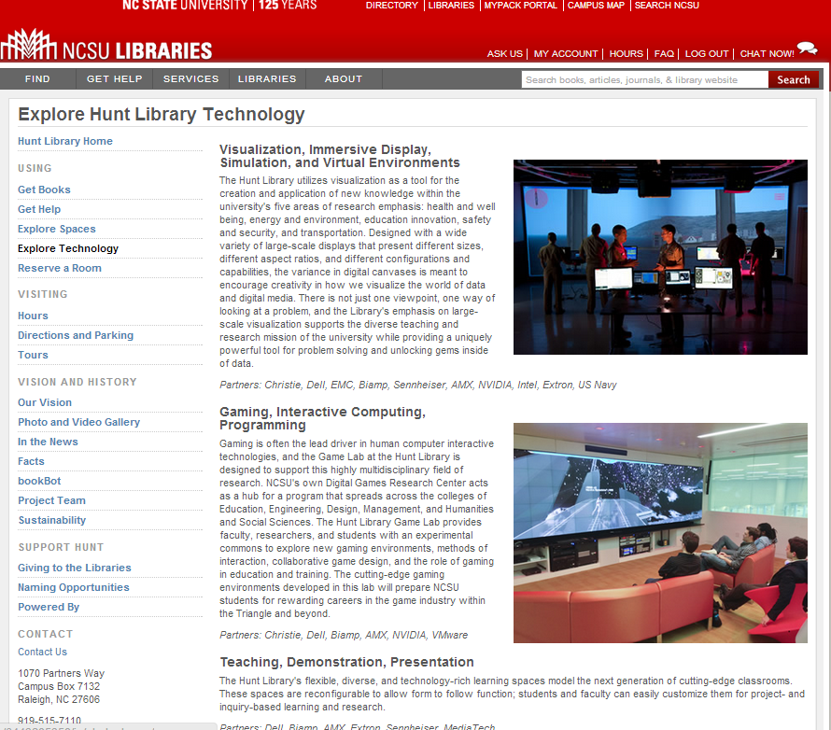
Space reconfigured
around experience,
expertise and
communication
rather than collections

Slide 62
A shift to engagement ..
the library as an actor in research and learning environments of its users.
Reduce infrastructure which does not
have a distinctive impact.
Innovate around new forms of engagement and around institutional patterns? Must become scalable and repeatable.

Slide 63
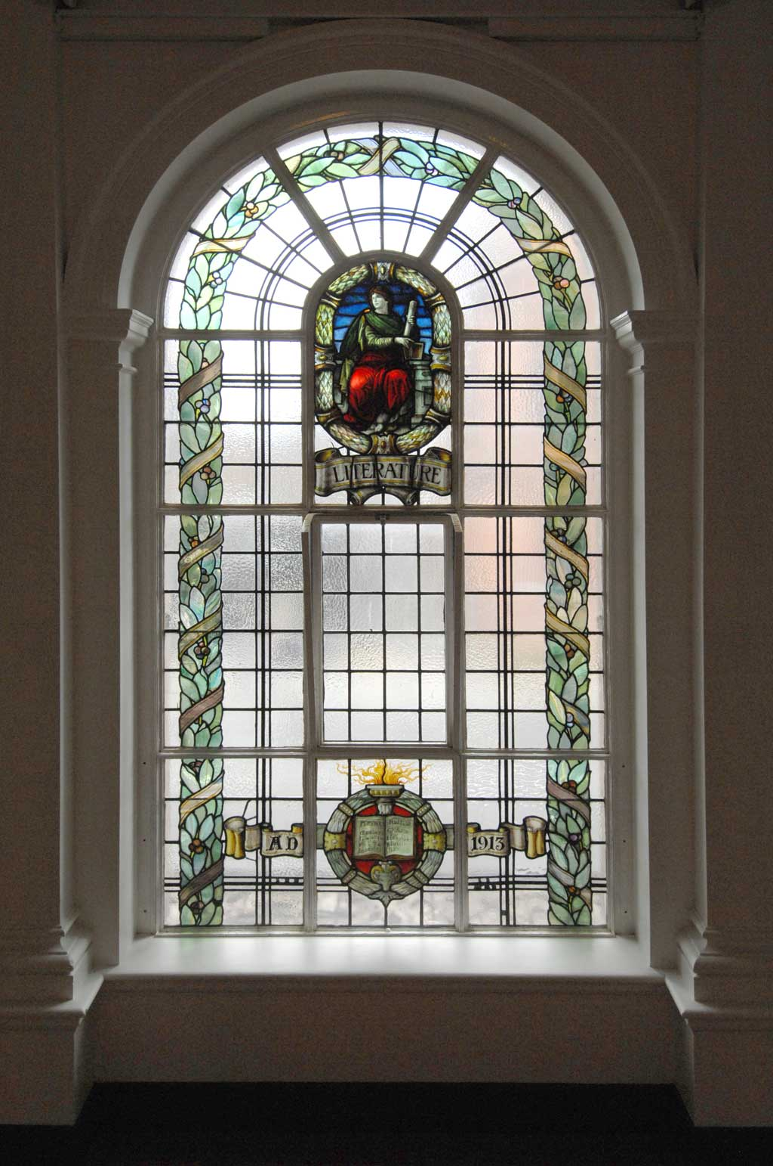
The library should not provide an argument for a particular case, but demonstrate that there is always another case to be made. The notion that the library is a place that has no agenda other than allowing people to invent their own agendas is what makes it an indispensable resource for a democracy. It is where we can learn not just to be readers, but to be the authors of our own destiny. Fintan O’Toole
Dublin City Public Libraries, Flickr: http://www.flickr.com/photos/dublincitypubliclibraries/6029467474/in/set-72157594513778442

